Slide 1
The place I would like to visit
Author: Kirichenko Daria
Б03 - 104

Slide 2
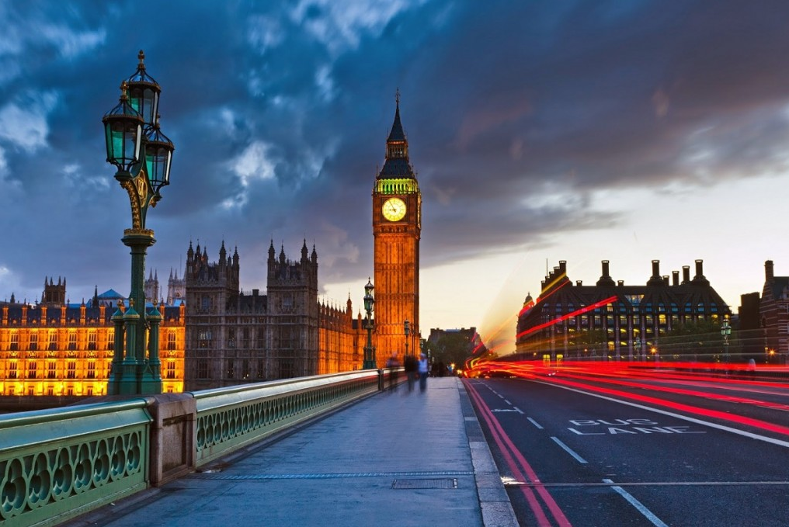
Contents
The British Library
Shakespeare at the Globe
The architecture
London parks
Green Park
Hyde Park

Slide 3
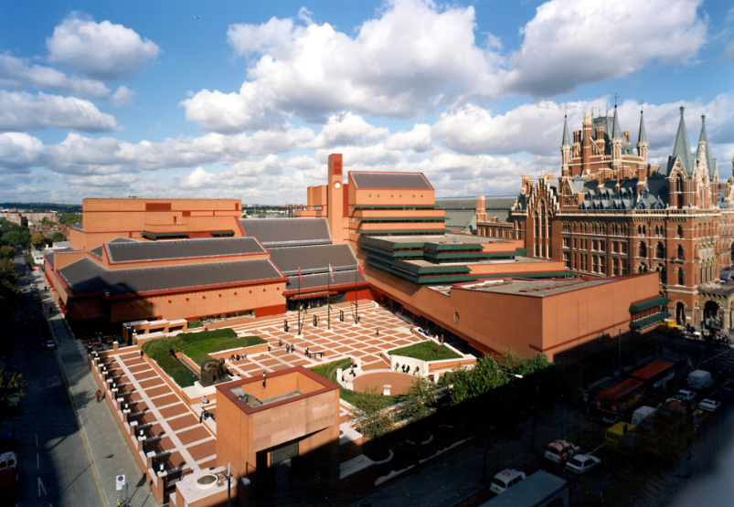
the British Library
The Grade I-listed British Library is the largest national library in the world with over 150 million catalogued items held inside, some dating back as far as 2000 BC. It’s home to 15th-century editions of Chaucer’s Canterbury Tales, original song sheets penned by the Beatles and the memorandum written by Lord Nelson two days before the Battle of Trafalgar. It also receives a copy of every single book published in the UK and Ireland.

Slide 4
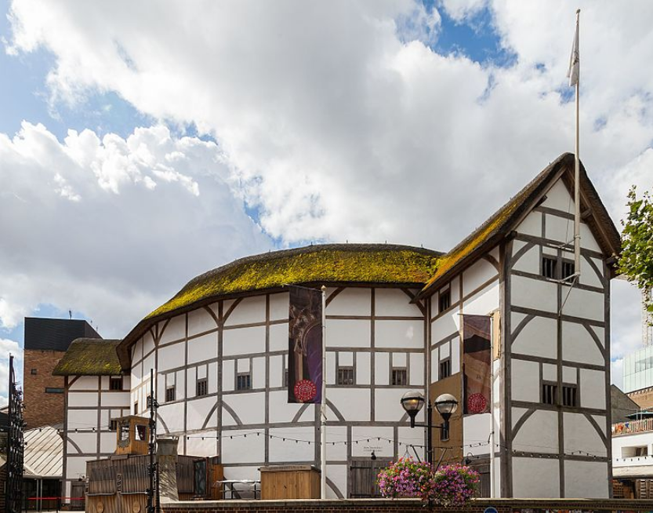
Shakespeare at the Globe
Shakespeare’s Globe is a painstakingly reconstructed version of the original Elizabethan playhouse, showcasing talks, tours and exhibitions to support its traditional productions. Although the Royal Shakespeare Company is based in the playwright’s home of Stratford-upon-Avon, it has consistently had a London presence, with productions taking place across the capital.

Slide 5
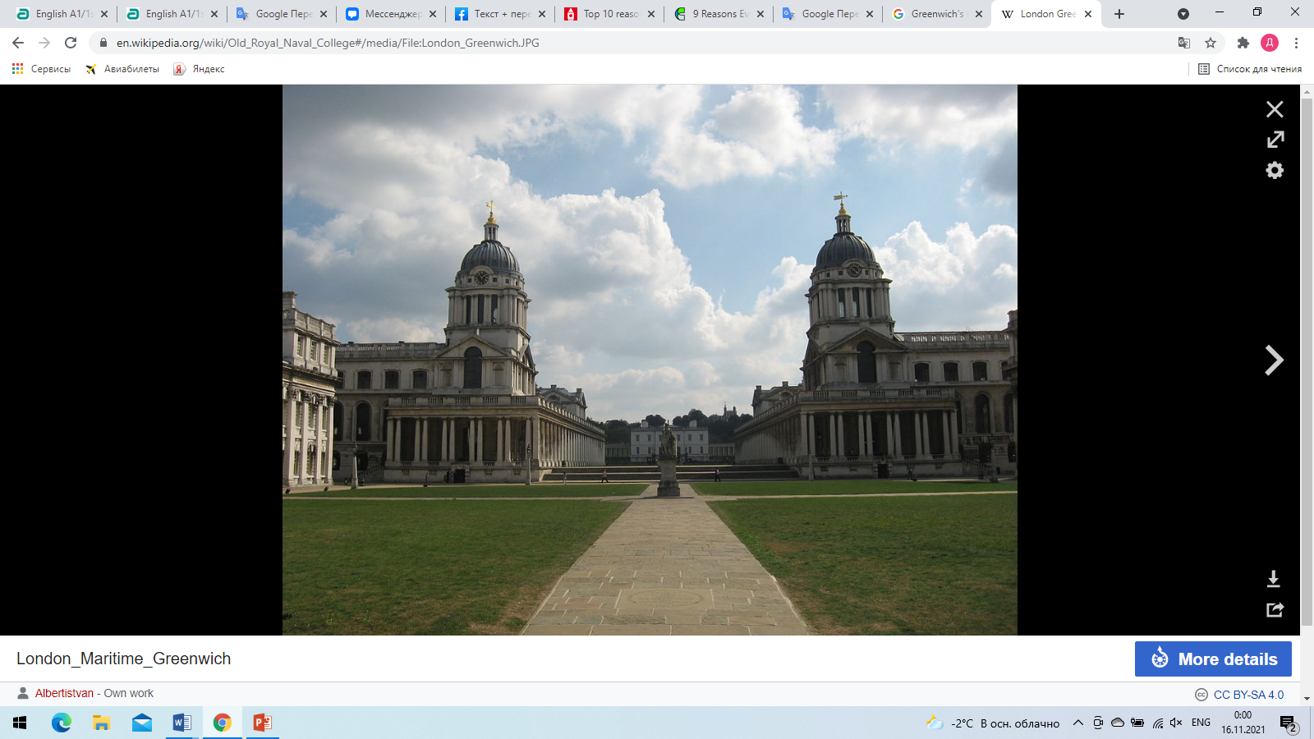
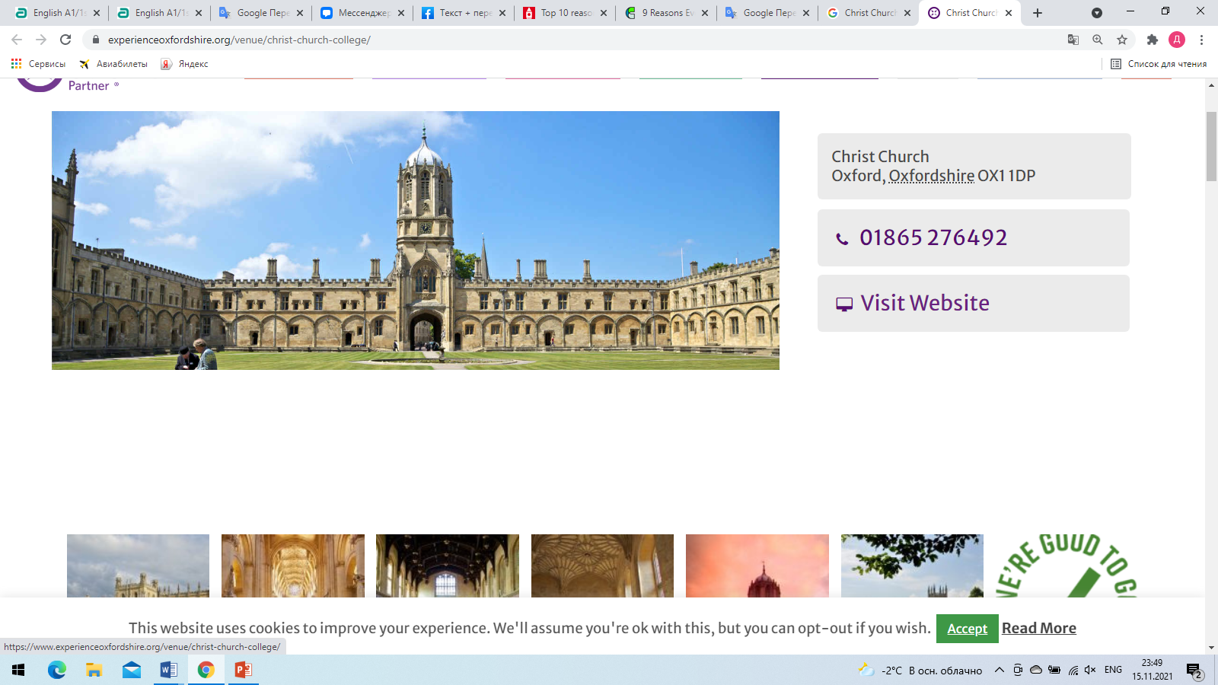
The architecture
Christ Church
Greenwich’s sprawling Royal Naval College

Slide 6
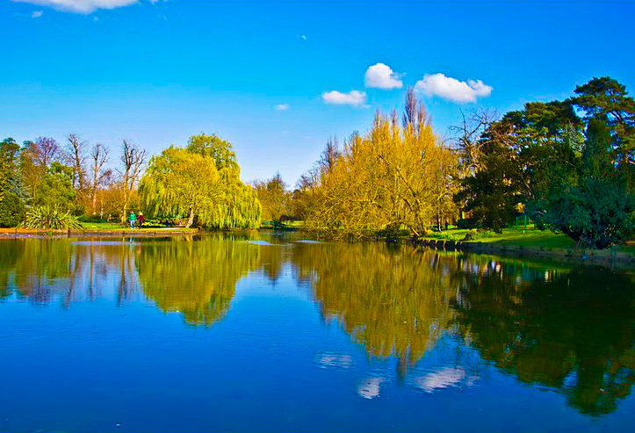
London parks
London is famous not only for its tourist attractions like Big Ben, Westminster Abbey, Buckingham Palace and others, but for beautiful and stunning parks as well. There are many park areas in London, each of which is loved both by citizens and toursits.

Slide 7
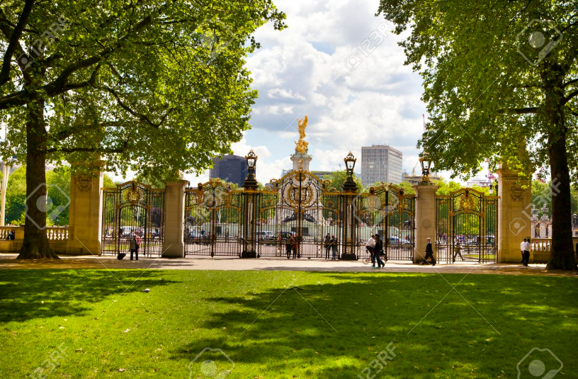
Green Park
Green Park is the smallest of capital's eight Royal Parks. It has a triangle shape and it is situated next to Buckingham Palace. Originally the park was opened as a hunting ground by Charles II. Only in 1826 Green Park became available to public. Nowadays Green Park attracts hundreds of people every day who come there to have picnics on grass, to lounge on alluring deckchairs or to walk around, delighting the atmosphere and nature.

Slide 8
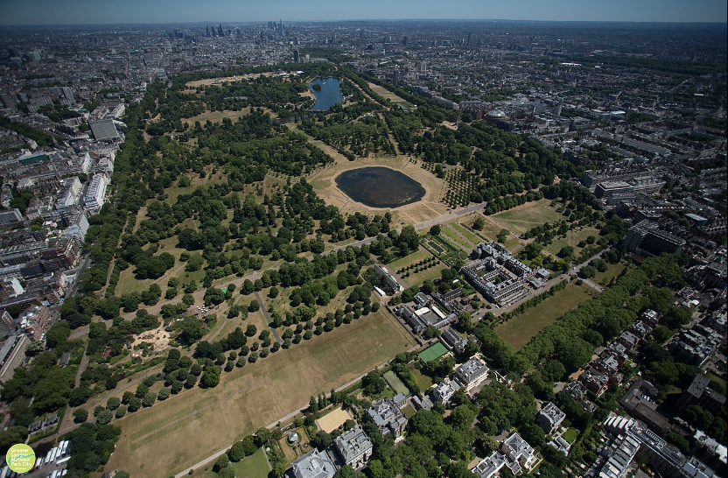
Hyde Park
Hyde Park - is also one of the Royal Parks but it is considered to be one of the largest ones and certainly the most famous. This park used to be a hunting area as well. Henry VIII appropriated this land from monks of Westminster Abbey for hunting deer. Even when it was open to the public, the park was visitied exclusively by the upper class. Now the park is a place of great interest not only bacause of its beauty but also of the oldest boat lake, Serpantine, that is located in the Hyde Park. It is possible to see ducks, swans and some other animals there. In addition Serpantine still remains the place where defferent demonstrations take place.

Slide 9
Thanks for your attention!

